Slide 1
Presented by:
Online Shopping
Shamim Ahammed
Sharmin
Jiniaur Baby
System Analysis & Design

Slide 2
Presented to:
Online Shopping
Supta Rechard Philip
Sr.Lecturer, Department of CSE
City University
System Analysis & Design

Slide 3
Online Shopping
Online Shopping
Project
System Analysis & Design

Slide 4

Online Shopping
Introduction
System Analysis & Design

Slide 5
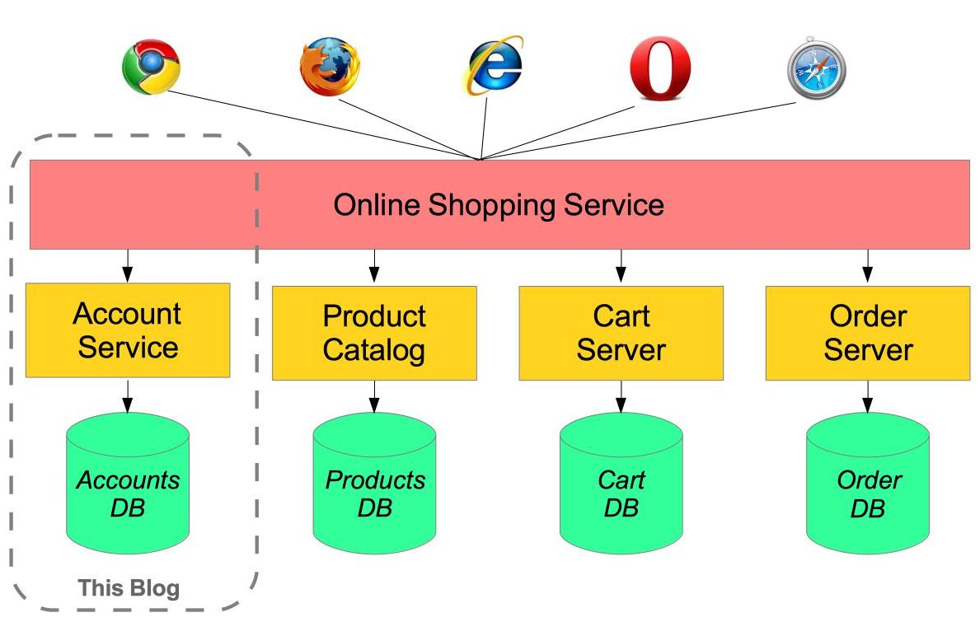
Project Structure
Online Shopping
Account Service
Product Catalog
Cart Service
Order Service
System Analysis & Design

Slide 6
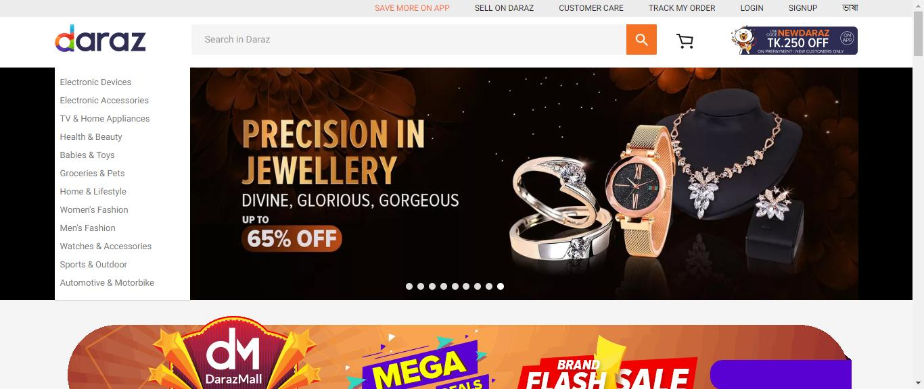
Related Project
Daraz.com
Daraz is a most popular online shopping site in Bangladesh.
System Analysis & Design

Slide 7
System Analysis
Online Shopping
Feasibility Study: In preliminary investigation feasibility study has three aspects
Technical Feasibility
Behavioral Feasibility
Economical Feasibility
System Analysis & Design

Slide 8
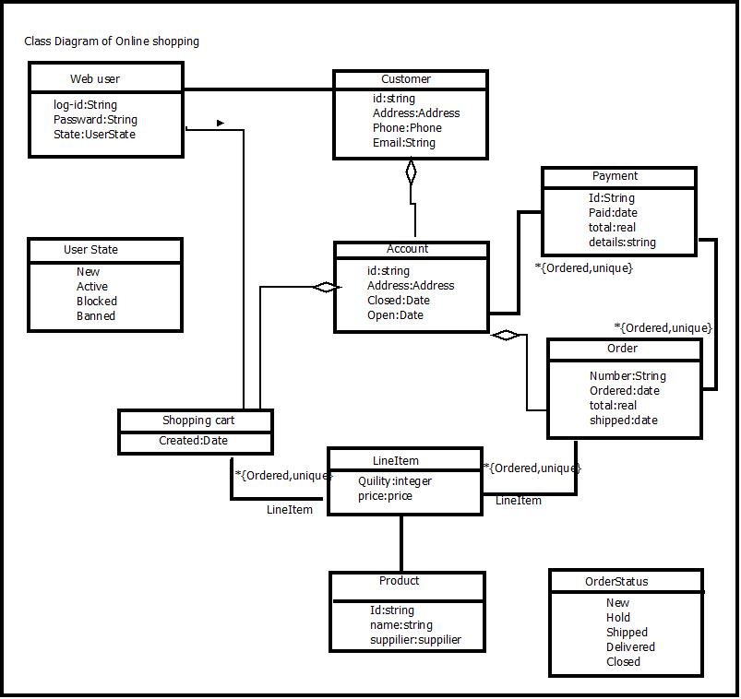
Class Diagram
Online Shopping
A description of a group of objects all with similar roles in the system
System Analysis & Design

Slide 9
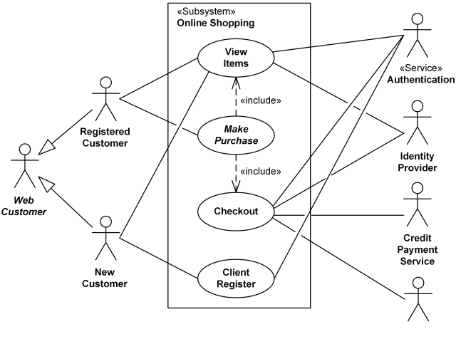
Use Case
Online Shopping
Web Customer actor uses some website to make purchases online. Top level use cases are View Items, Make Purchase and Client Register. View Items use case could be used by customer as top-level use case if customer only wants to find and see some products. This use case could also be used as a part of Make Purchase use case
System Analysis & Design

Slide 10
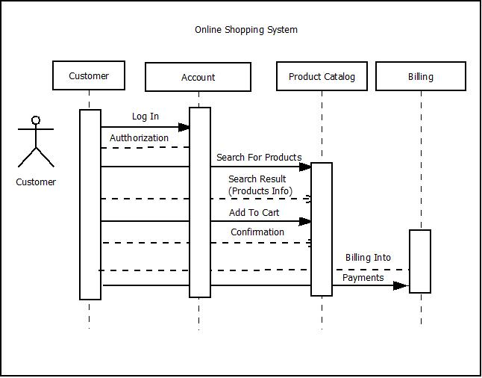
Sequence Diagram
Online Shopping
Many project managers and engineers use sequence diagrams in UML to get a better idea of how tasks within a project will function, overlap, and move between objects or components. Create sequence diagrams to display interactions between objects and the order in which those interactions occur.
System Analysis & Design

Slide 11
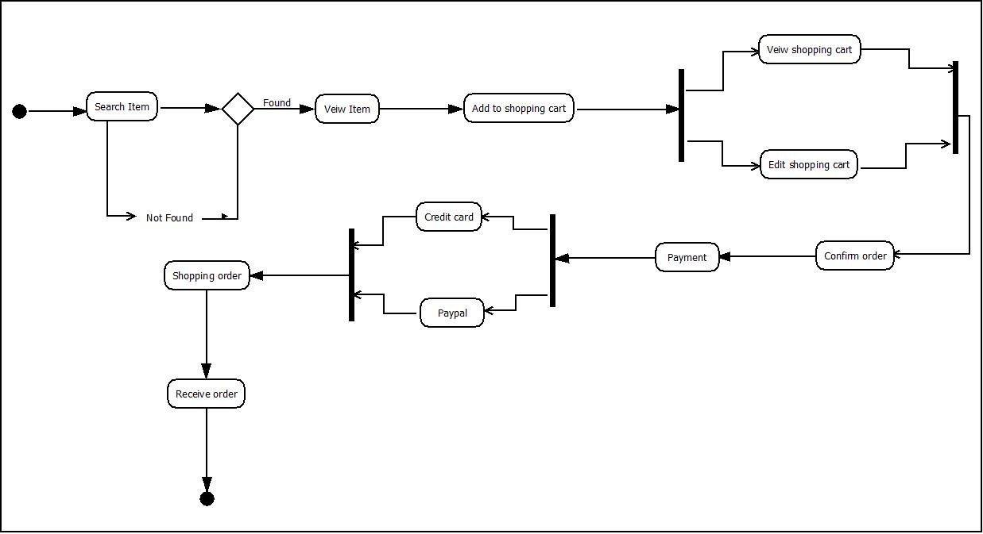
Activity Diagram
Online Shopping
Activity diagram is another important diagram in UML to describe the dynamic aspects of the system. Activity diagram is basically a flowchart to represent the flow from one activity to another activity. The activity can be described as an operation of the system. The control flow is drawn from one operation to another
System Analysis & Design

Slide 12
Thanks
Online Shopping
System Analysis & Design

